Slide 1
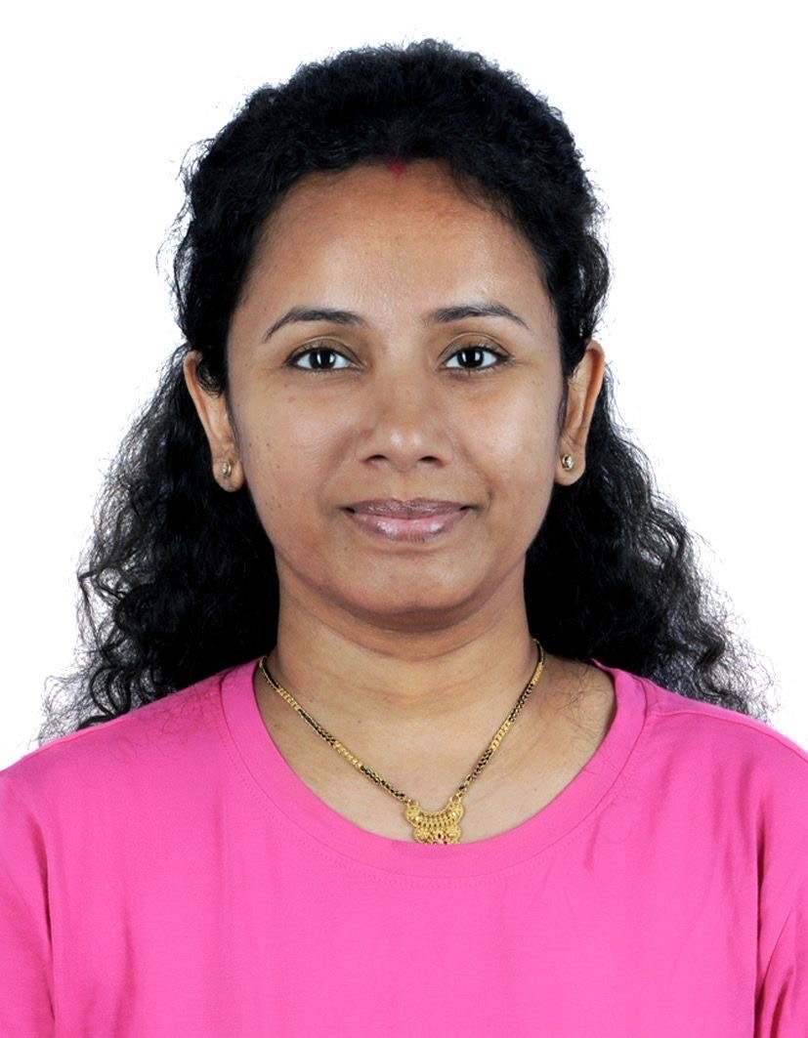
Richa Gupta - Manager
Professional Background
Professional Experience
Capgemini (June 2024 - Present)
Role: Manager
Fidelity Information Services(May 2016 – Feb 2023)
Role: Technical Lead
worked as Lead Data Scientist in previous organization with overall 9.6 years of experience into IT industry and 4.3 years of hands-on experience in AI/ ML
Skilled in leveraging advanced machine learning techniques to solve complex industrial challenges.
Proficient in utilizing industrial data analysis to identify opportunities for innovative solutions and improvements.
Spearheaded the development of a credit product using AI to optimize customer offers and minimize risks.
Projects
AI Credits:
Collaborated with the new client initiatives team to develop an AI-based credit platform, creating predictive models for assessing repayment capabilities and utilizing bank customer data for targeted product promotions.
Implemented an end-to-end data science lifecycle, aligning solutions with business objectives to achieve strategic goals effectively in addressing the problem statement.
Applied Ensemble ML Models, statistical analysis, and visualization techniques to optimize the AI-driven credit platform.
Directed a team of 7 personnel focused on implementing resolutions and updates, ensuring seamless integration and optimal performance of systems.
Sentiment Analysis:
Worked as Technical Lead and conducted sentiment analysis on bank product reviews by implementing a range of text preprocessing techniques and feature engineering methods, including Transformer, BERT based Uncased Subsequently, utilized these models for predictive analysis.
Conducted regular assessments of project milestones and team performance to maintain focus and drive productivity, effectively managing resources to meet objectives.
Similar Incident grouping:
Managed a Team and employed diverse clustering techniques such as K-Means to categorize and group similar incidents reported by clients on daily basis.
Streamlined data processing by compiling, cleaning and manipulating datasets for accurate analysis and interpretation, enabling informed decision making.
Richa Gupta
Manager
Core Competencies
Key skills
Designed, developed various AI/ ML solutions
Proficient in Python, Numpy Pandas, SkLearn, TensorFlow, Keras
Credit Risk Models, NLP, Deep Learning, Forecasting and Gen AI basics
End-to-end Data Science Lifecycle.
Applied Various Models like Logistic Regression, Random Forest, XgBoost, Transformers, BERT
Programming Language: Python
ML/DL Techniques: EDA, Decision trees, logistic regression, linear regression, ensemble models (bagging and boosting techniques such as Random Forest, XGBoost, GBM), clustering, and NLP, GenAI Basics, on upskill path on Time Series Forecasting, RAG.
Tools and Environments: JIRA, Anaconda, Jupyter Notebook

